Slide 2
develop understanding about basics of speed, distance, time, average speed, and units of measurement,
derive different units, important facts and formulae relating to speed, distance, time, and average speed.

Slide 3
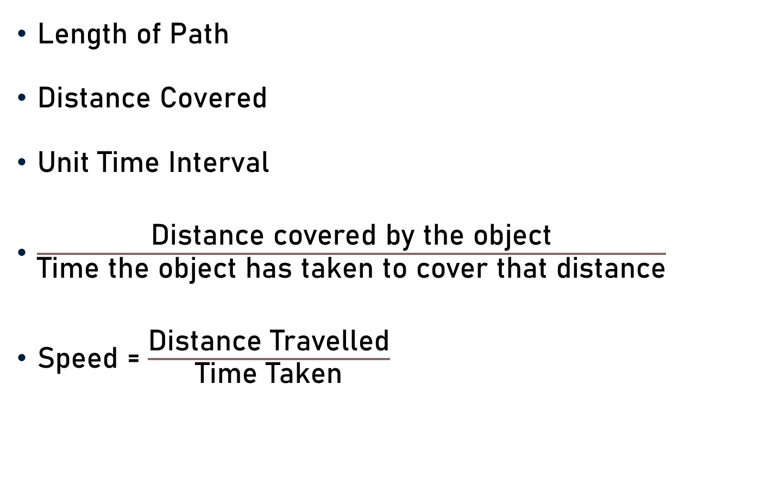
Speed, Distance, & Time
Length of Path
Distance Covered
Unit Time Interval
$\frac{\text{Distance} \text{covered} \text{by} \text{the} \text{object}}{\text{Time} \text{the} \text{object} \text{has} \text{taken} \text{to} \text{cover} \text{that} \text{distance}}$
Speed = $\frac{\text{Distance} \text{T}\text{ravelled}}{\text{Time} \text{T}\text{aken}}$

Slide 4

Speed, Distance, & Time
D
D = Distance
T = Time
S = Speed
Speed (S) = $\frac{\text{Distance}\text{ (}\text{D}\text{)}}{\text{Time}\text{ (}\text{T}\text{)}}$
Speed x $\text{Time}$=$\text{Distance}$
$\text{Time}$= $\frac{\text{Distance}}{\text{Speed}}$
X
Y

Slide 5
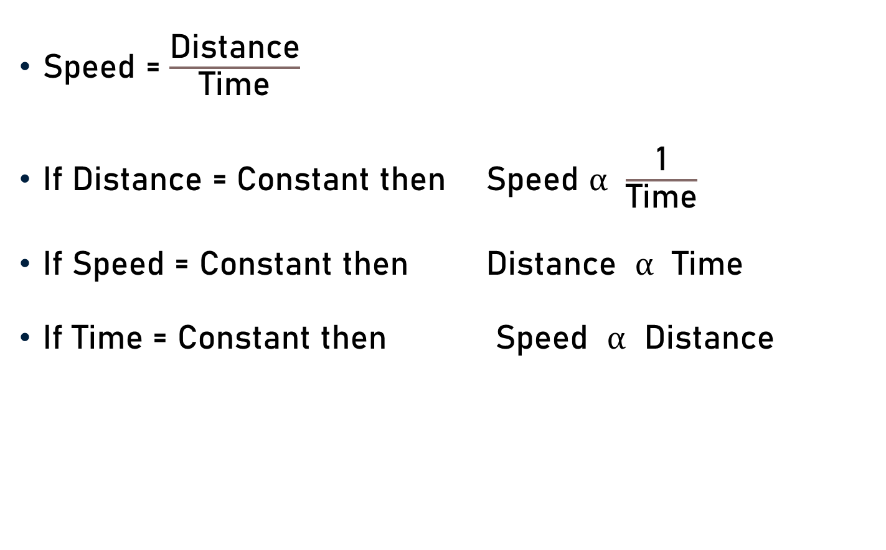
Speed, Distance, & Time
Speed = $\frac{\text{Distance}}{\text{Time}}$
If Distance = Constant then Speed $α$ $\frac{\text{1}}{\text{Time}}$
If Speed = Constant then $\text{Distance}$ $α$ $\text{Time}$
If Time = Constant then Speed $α$ $\text{Distance}$

Slide 6
Units of Measurement
Distance – Kilometre (Km)
Time - Hours (h)
Speed - Kilometre per hour (Km/h)
Distance – Metre (m)
Time - Seconds (s)
Speed - Metre per seconds (m/s)

Slide 7
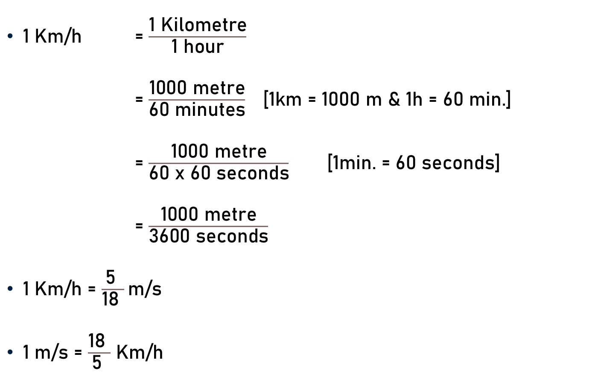
Conversion of Units
$\text{1}$ Km/h = $\frac{\text{1} \text{K}\text{ilometre}}{\text{1} \text{hour}}$
= $\frac{\text{1000 }\text{metre}}{\text{60 }\text{minutes}}$ [1km = 1000 m & 1h = 60 min.]
= $\frac{\text{1000 }\text{metre}}{\text{60} \text{x}\text{ 60 }\text{seconds}}$ [1min. = 60 seconds]
= $\frac{\text{1000 }\text{metre}}{\text{36}\text{0}\text{0 }\text{seconds}}$
$\text{1}$ Km/h = $\frac{\text{5} }{\text{18 }}\text{m}\text{/}\text{s}$
$\text{1}$ $\text{m}\text{/}\text{s}$ = $\frac{\text{18} }{\text{5 }}$ Km/h
5
18

Slide 8

Conversion of Units
$\text{1}$ Km/h = $\frac{\text{5} }{\text{18 }}\text{m}\text{/}\text{s}$ and $\text{1}$ $\text{m}\text{/}\text{s}$ = $\frac{\text{18} }{\text{5 }}$ Km/h
36 Km/h = 36 x $\frac{\text{5} }{\text{18 }}$ $\text{m}\text{/}\text{s}$
= 10 $\text{m}\text{/}\text{s}$
20 m/s = 20 x $\frac{\text{18} }{\text{5 }}$ Km/h
= 72 Km/h
2
4

Slide 9
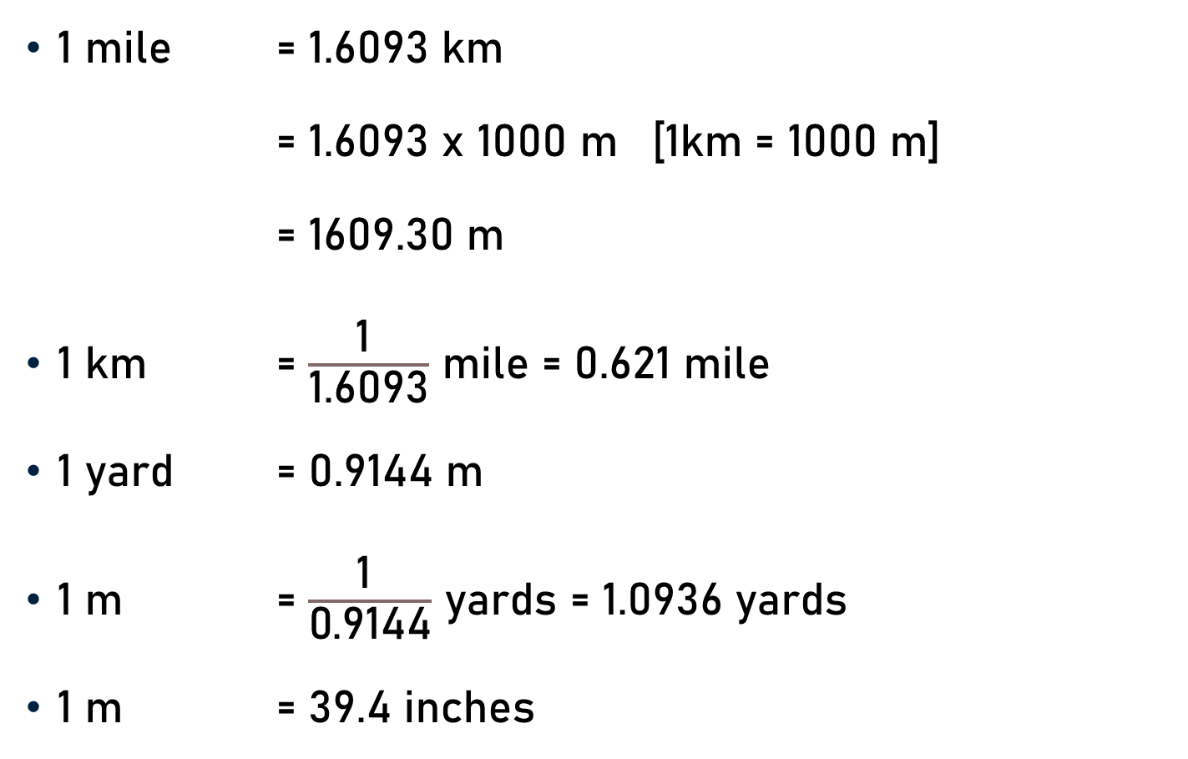
Conversion of Units
1 mile = 1.6093 km
= 1.6093 x 1000 m [1km = 1000 m]
= 1609.30 m
1 km = $\frac{\text{1} }{\text{1.6093}}$ mile = 0.621 mile
1 yard = 0.9144 m
1 m = $\frac{\text{1} }{\text{0.9144}}$ yards = 1.0936 yards
1 m = 39.4 inches

Slide 10

Average Speed
Total Distance Covered
Total Time Taken
Average Speed = $\frac{\text{Total} \text{Distance} \text{Covered} }{\text{Total} \text{Time} \text{Taken} }$

Slide 11
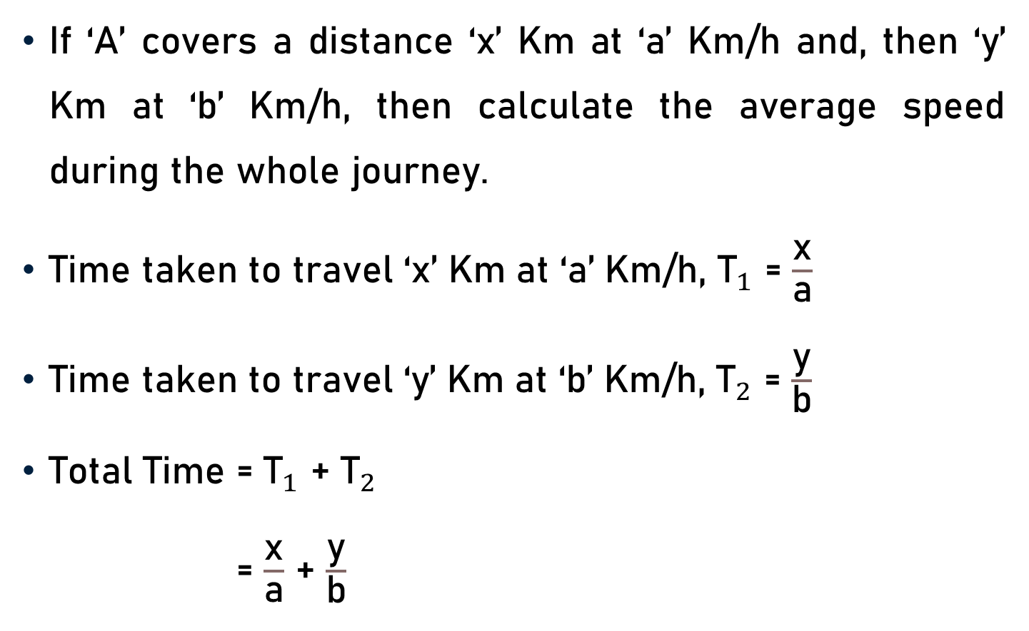
Average Speed
If ‘A’ covers a distance ‘x’ Km at ‘a’ Km/h and, then ‘y’ Km at ‘b’ Km/h, then calculate the average speed during the whole journey.
Time taken to travel ‘x’ Km at ‘a’ Km/h, ${\text{T}}_{1}$ = $\frac{\text{x}}{\text{a}}$
Time taken to travel ‘y’ Km at ‘b’ Km/h, ${\text{T}}_{2}$ = $\frac{\text{y}}{\text{b}}$
Total Time = ${\text{T}}_{1}$ + ${\text{T}}_{2}$
= $\frac{\text{x}}{\text{a}}$ + $\frac{\text{y}}{\text{b}}$

Slide 12
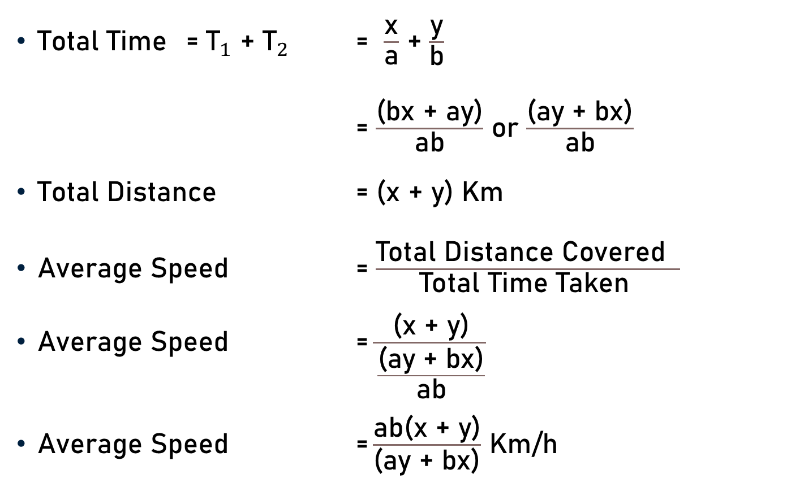
Average Speed
Total Time = ${\text{T}}_{1}$ + ${\text{T}}_{2}$ = $\frac{\text{x}}{\text{a}}$ + $\frac{\text{y}}{\text{b}}$
= $\frac{\text{(}\text{bx} \text{+} \text{ay}\text{)}}{\text{ab}}$ or $\frac{\text{(}\text{ay}\text{ + }\text{bx}\text{)}}{\text{ab}}$
Total Distance = (x + y) Km
Average Speed = $\frac{\text{Total} \text{Distance} \text{Covered} }{\text{Total} \text{Time} \text{Taken} }$
Average Speed = $\frac{\text{(}\text{x}\text{ + }\text{y}\text{)}}{\frac{\text{(}\text{ay}\text{ + }\text{bx}\text{)}}{\text{ab}}}$
Average Speed $\text{=}\frac{\text{ab}\text{(}\text{x}\text{ + }\text{y}\text{)}}{\text{(}\text{ay}\text{ + }\text{bx}\text{)}}$ Km/h

Slide 13
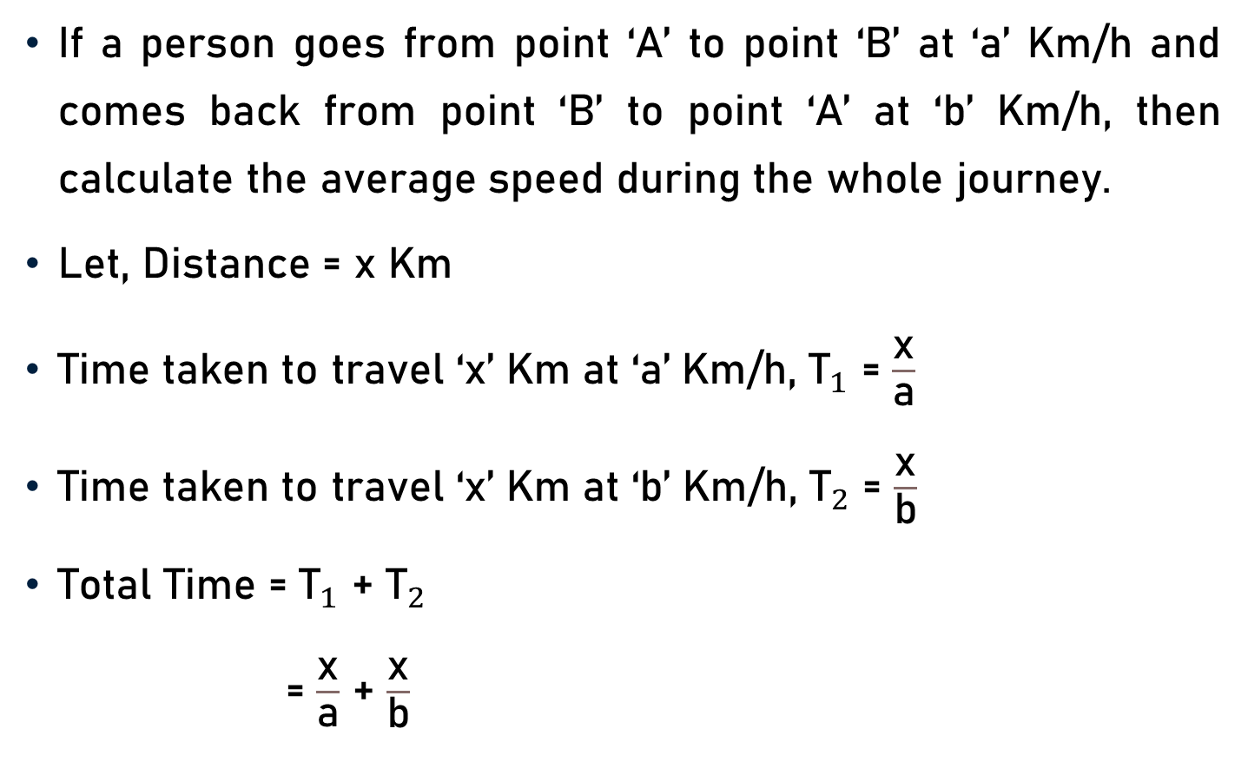
Average Speed
If a person goes from point ‘A’ to point ‘B’ at ‘a’ Km/h and comes back from point ‘B’ to point ‘A’ at ‘b’ Km/h, then calculate the average speed during the whole journey.
Let, Distance = x Km
Time taken to travel ‘x’ Km at ‘a’ Km/h, ${\text{T}}_{1}$ = $\frac{\text{x}}{\text{a}}$
Time taken to travel ‘x’ Km at ‘b’ Km/h, ${\text{T}}_{2}$ = $\frac{\text{x}}{\text{b}}$
Total Time = ${\text{T}}_{1}$ + ${\text{T}}_{2}$
= $\frac{\text{x}}{\text{a}}$ + $\frac{\text{x}}{\text{b}}$

Slide 14
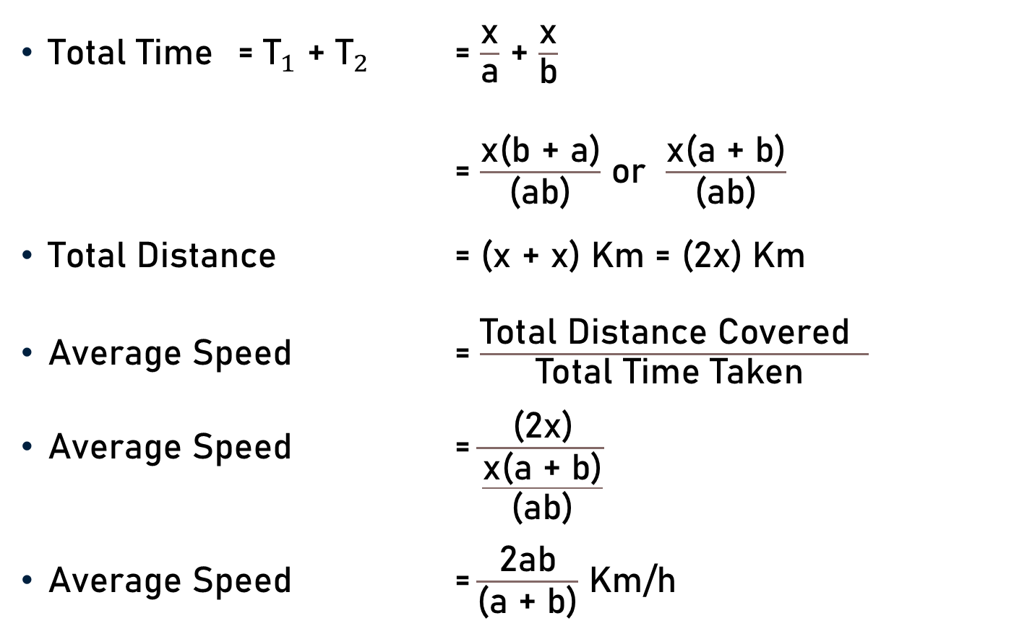
Average Speed
Total Time = ${\text{T}}_{1}$ + ${\text{T}}_{2}$ = $\frac{\text{x}}{\text{a}}$ + $\frac{\text{x}}{\text{b}}$
= $\frac{\text{x}\text{(}\text{b}\text{ + }\text{a}\text{)}}{\text{(}\text{ab}\text{)}}$ or $\frac{\text{x}\text{(}\text{a}\text{ + }\text{b}\text{)}}{\text{(}\text{ab}\text{)}}$
Total Distance = (x + x) Km = (2x) Km
Average Speed = $\frac{\text{Total} \text{Distance} \text{Covered} }{\text{Total} \text{Time} \text{Taken} }$
Average Speed = $\frac{\text{(}\text{2}\text{x}\text{)}}{\frac{\text{x}\text{(}\text{a}\text{ + }\text{b}\text{)}}{\text{(}\text{ab}\text{)}}}$
Average Speed $\text{=}\frac{\text{2}\text{ab}}{\text{(}\text{a}\text{ + }\text{b}\text{)}}$ Km/h

Slide 15
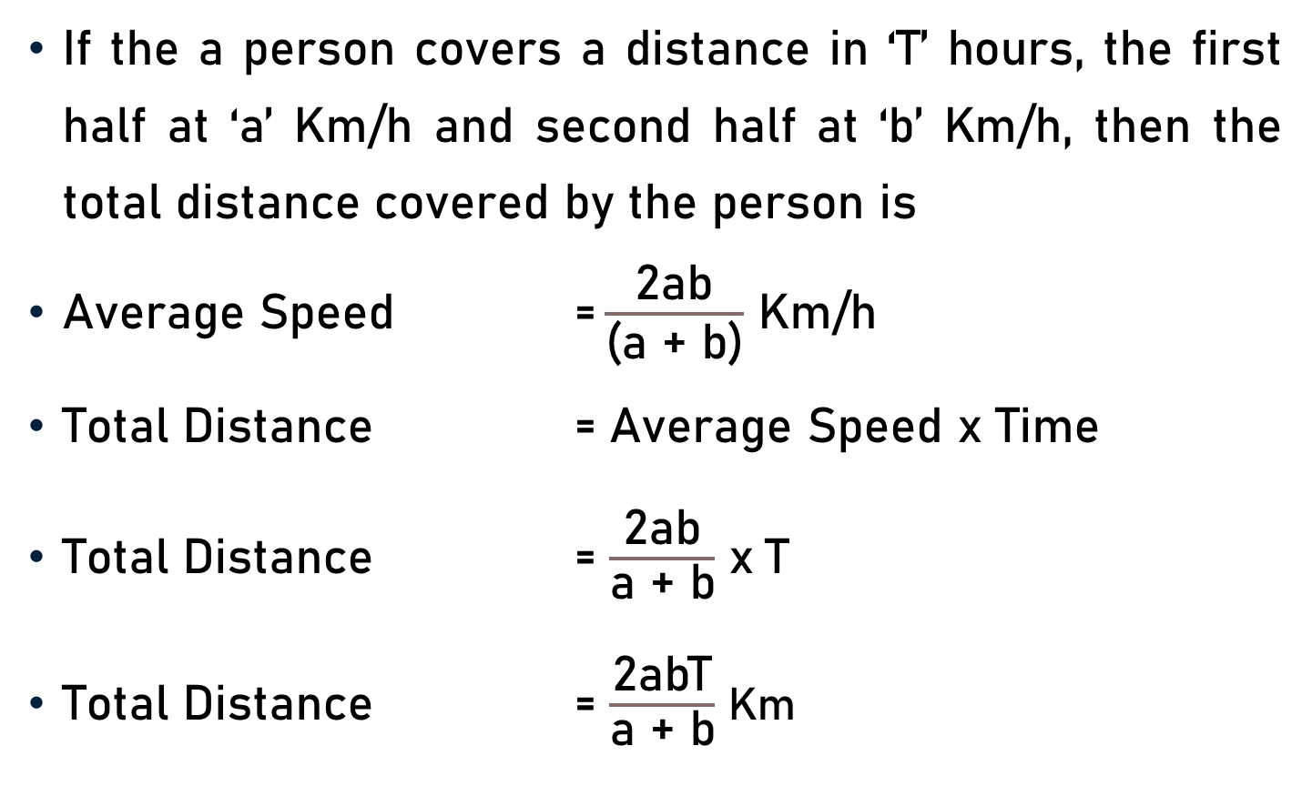
Total Distance
If the a person covers a distance in ‘T’ hours, the first half at ‘a’ Km/h and second half at ‘b’ Km/h, then the total distance covered by the person is
Average Speed $\text{=}\frac{\text{2}\text{ab}}{\text{(}\text{a}\text{ + }\text{b}\text{)}}$ Km/h
Total Distance = Average Speed x Time
Total Distance = $\frac{\text{2}\text{ab}}{\text{a}\text{ + }\text{b}}$ x$\text{T}$
Total Distance = $\frac{\text{2}\text{abT}}{\text{a}\text{ + }\text{b}}$ Km

Slide 16
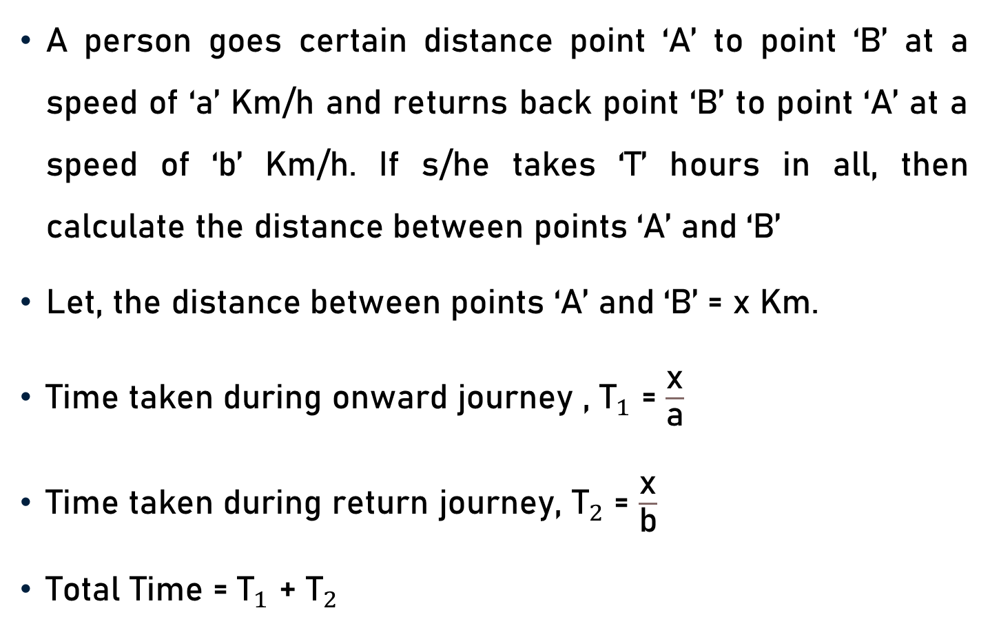
Distance
A person goes certain distance point ‘A’ to point ‘B’ at a speed of ‘a’ Km/h and returns back point ‘B’ to point ‘A’ at a speed of ‘b’ Km/h. If s/he takes ‘T’ hours in all, then calculate the distance between points ‘A’ and ‘B’
Let, the distance between points ‘A’ and ‘B’ = x Km.
Time taken during onward journey , ${\text{T}}_{1}$ = $\frac{\text{x}}{\text{a}}$
Time taken during return journey, ${\text{T}}_{2}$ = $\frac{\text{x}}{\text{b}}$
Total Time = ${\text{T}}_{1}$ + ${\text{T}}_{2}$

Slide 17
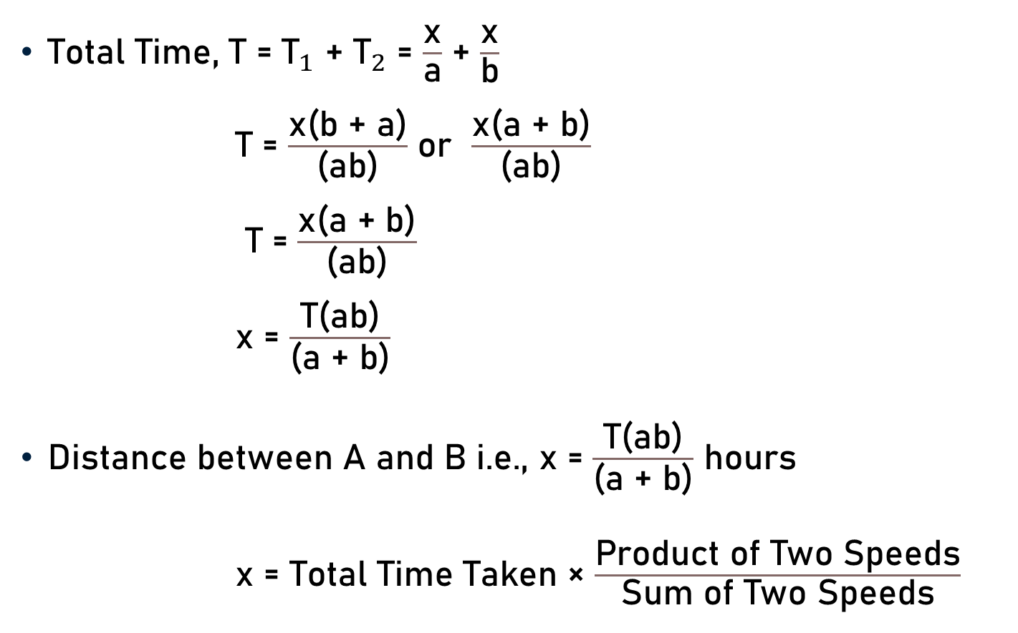
Distance
Total Time, T = ${\text{T}}_{1}$ + ${\text{T}}_{2}$ = $\frac{\text{x}}{\text{a}}$ + $\frac{\text{x}}{\text{b}}$
T = $\frac{\text{x}\text{(}\text{b}\text{ + }\text{a}\text{)}}{\text{(}\text{ab}\text{)}}$ or $\frac{\text{x}\text{(}\text{a}\text{ + }\text{b}\text{)}}{\text{(}\text{ab}\text{)}}$
T = $\frac{\text{x}\text{(}\text{a}\text{ + }\text{b}\text{)}}{\text{(}\text{ab}\text{)}}$
x = $\frac{\text{T}\text{(}\text{ab}\text{)}}{\text{(}\text{a}\text{ + }\text{b}\text{)}}$
Distance between A and B i.e., x = $\frac{\text{T}\text{(}\text{ab}\text{)}}{\text{(}\text{a}\text{ + }\text{b}\text{)}}$ hours
x = Total Time Taken × $\frac{\text{Product} \text{of} \text{Two} \text{Speeds}}{\text{Sum} \text{of} \text{Two} \text{Speeds}}$

Slide 18
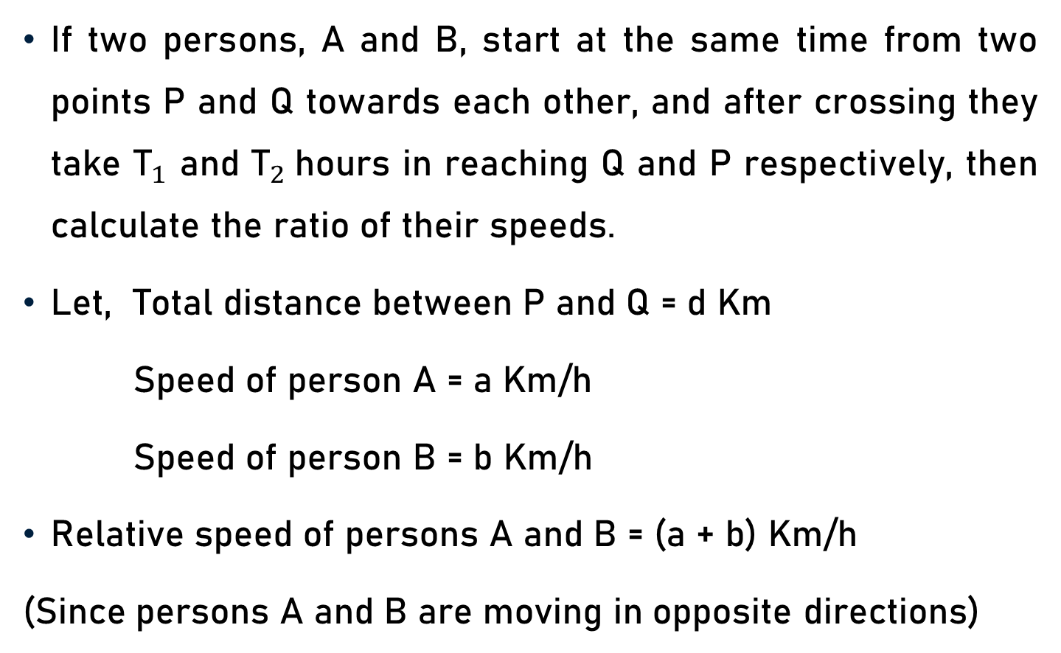
Ratio of Speeds of Two Persons
If two persons, A and B, start at the same time from two points P and Q towards each other, and after crossing they take ${\text{T}}_{1}$ and ${\text{T}}_{2}$hours in reaching Q and P respectively, then calculate the ratio of their speeds.
Let, Total distance between P and Q = d Km
Speed of person A = a Km/h
Speed of person B = b Km/h
Relative speed of persons A and B = (a + b) Km/h
(Since persons A and B are moving in opposite directions)

Slide 19
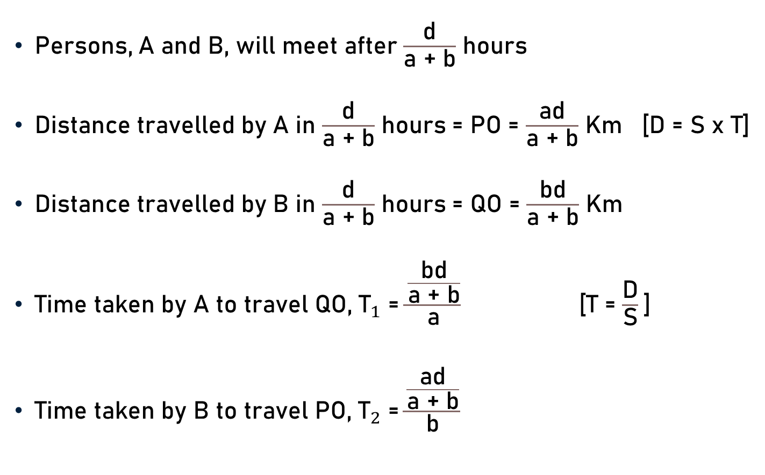
Ratio of Speeds of Two Persons
Persons, A and B, will meet after $\frac{\text{d}}{\text{a}\text{ + }\text{b}}$ hours
Distance travelled by A in $\frac{\text{d}}{\text{a}\text{ + }\text{b}}$ hours = PO = $\frac{\text{ad}}{\text{a}\text{ + }\text{b}}$ Km [D = S x T]
Distance travelled by B in $\frac{\text{d}}{\text{a}\text{ + }\text{b}}$ hours = QO = $\frac{\text{bd}}{\text{a}\text{ + }\text{b}}$ Km
Time taken by A to travel QO, ${\text{T}}_{1}$ = $\frac{\frac{\text{b}\text{d}}{\text{a}\text{ + }\text{b}}}{\text{a}}$ [T = $\frac{\text{D}}{\text{S}}$]
Time taken by B to travel PO, ${\text{T}}_{2}$ = $\frac{\frac{\text{a}\text{d}}{\text{a}\text{ + }\text{b}}}{\text{b}}$

Slide 20

Ratio of Speeds of Two Persons
$\frac{\frac{\text{ad}}{\text{a}\text{ + }\text{b}}}{\text{b}}$ $\text{=}$ ${\text{T}}_{2}$ and $\frac{\frac{\text{bd}}{\text{a}\text{ + }\text{b}}}{\text{a}}$ = ${\text{T}}_{1}$
$\frac{\frac{\frac{\text{ad}}{\text{a}\text{ + }\text{b}}}{\text{b}}}{\frac{\frac{\text{bd}}{\text{a}\text{ + }\text{b}}}{\text{a}}}$ = $\frac{{\text{T}}_{2}}{{\text{T}}_{1}}$
${\left(\frac{\text{a}}{\text{b}}\right)}^{2}$ = $\frac{{\text{T}}_{2}}{{\text{T}}_{1}}$
$\frac{\text{a}}{\text{b}}$ = $\frac{\sqrt{T_{2}}}{\sqrt{T_{1}}}$
$\frac{\text{a}\text{ (}\text{i}\text{.}\text{e}\text{., }\text{Speed} \text{of} \text{A}\text{)}}{\text{b}\text{(}\text{i}\text{.}\text{e}\text{., }\text{Speed} \text{of} \text{B}\text{)}}$ = $\frac{\sqrt{T_{2}}}{\sqrt{T_{1}}}$

Slide 21
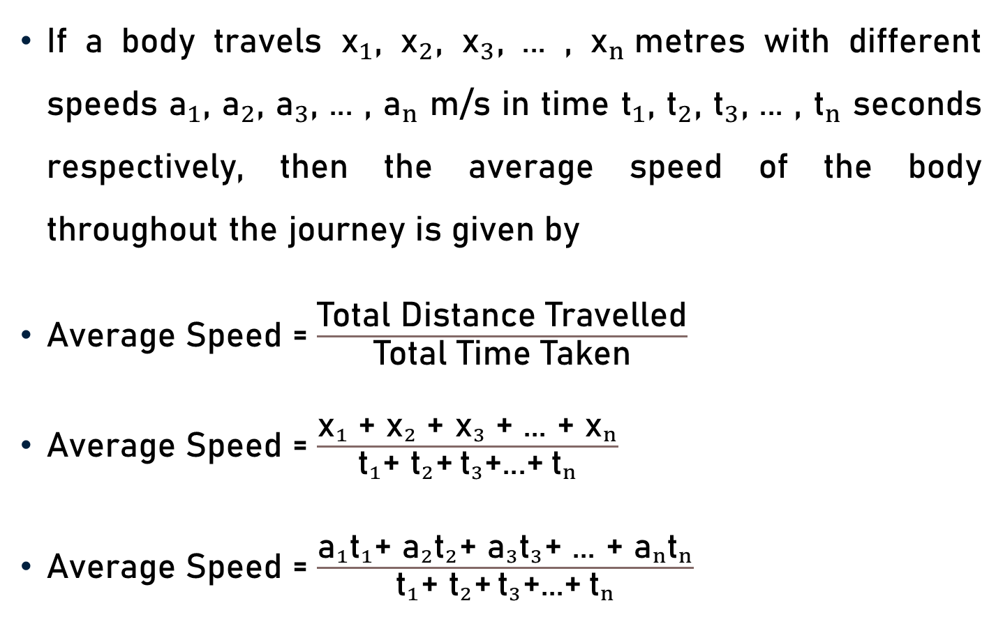
Average Speed - Journey
If a body travels ${\text{x}}_{1}$, ${\text{x}}_{2}$, ${\text{x}}_{3}$, ... , ${\text{x}}_{n}$metres with different speeds ${\text{a}}_{1}$, ${\text{a}}_{2}$, ${\text{a}}_{3}$, ... , ${\text{a}}_{n}$ m/s in time ${\text{t}}_{1}$, ${\text{t}}_{2}$, ${\text{t}}_{3}$, ... , ${\text{t}}_{n}$ seconds respectively, then the average speed of the body throughout the journey is given by
Average Speed = $\frac{\text{Total} \text{Distance} \text{Travelled}}{\text{Total} \text{Time} \text{Taken}}$
Average Speed = $\frac{{\text{x}}_{1}\text{ +} {\text{x}}_{2}\text{ +} {\text{x}}_{3}\text{ +}\text{ ... }\text{+} {\text{x}}_{n}}{{\text{t}}_{1}\text{+} {\text{t}}_{2}\text{+} {\text{t}}_{3}\text{+...+} {\text{t}}_{n}}$
Average Speed = $\frac{{\text{a}}_{1}{\text{t}}_{1}\text{+ }{\text{a}}_{2}{\text{t}}_{2}\text{+ }{\text{a}}_{3}{\text{t}}_{3}\text{+ ... + }{\text{a}}_{n}{\text{t}}_{n}}{{\text{t}}_{1}\text{+ }{\text{t}}_{2}\text{+} {\text{t}}_{3}\text{+...+} {\text{t}}_{n}}$

Slide 22
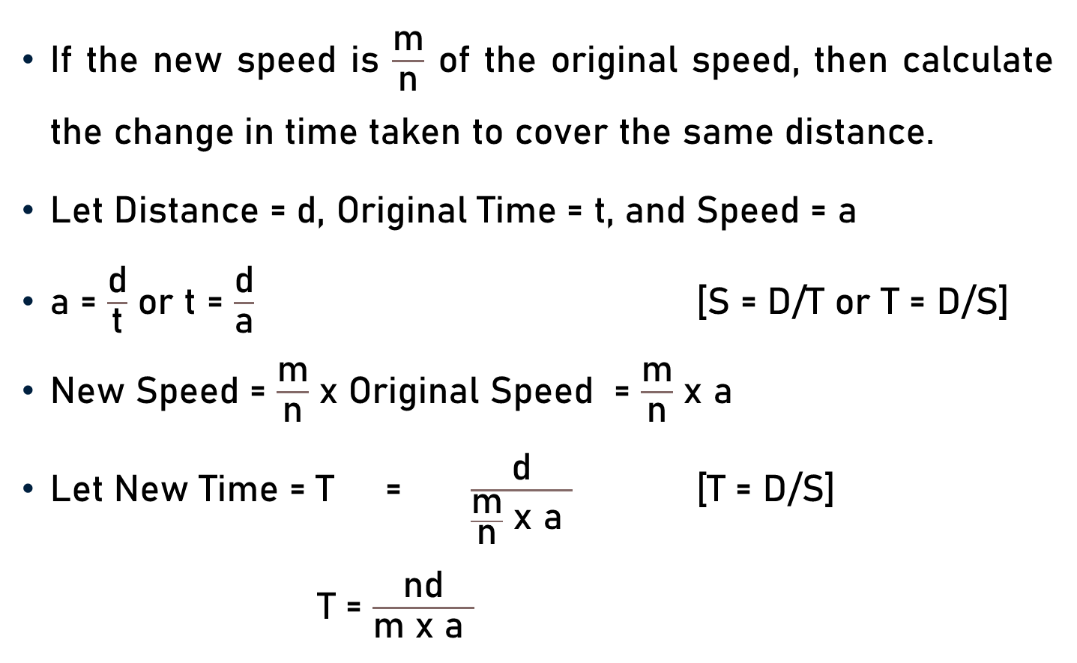
Change in Time – Cover Same Distance
If the new speed is $\frac{\text{m}}{\text{n}}$ of the original speed, then calculate the change in time taken to cover the same distance.
Let Distance = d, Original Time = t, and Speed = a
a = $\frac{\text{d}}{\text{t}}$ or t = $\frac{\text{d}}{\text{a}}$ [S = D/T or T = D/S]
New Speed = $\frac{\text{m}}{\text{n}}$ x Original Speed = $\frac{\text{m}}{\text{n}}$ x a
Let New Time = T = $\frac{\text{d}}{\frac{\text{m}}{\text{n}} \text{x} \text{a} }$ [T = D/S]
T = $\frac{\text{nd}}{\text{m} \text{x} \text{a} }$

Slide 23
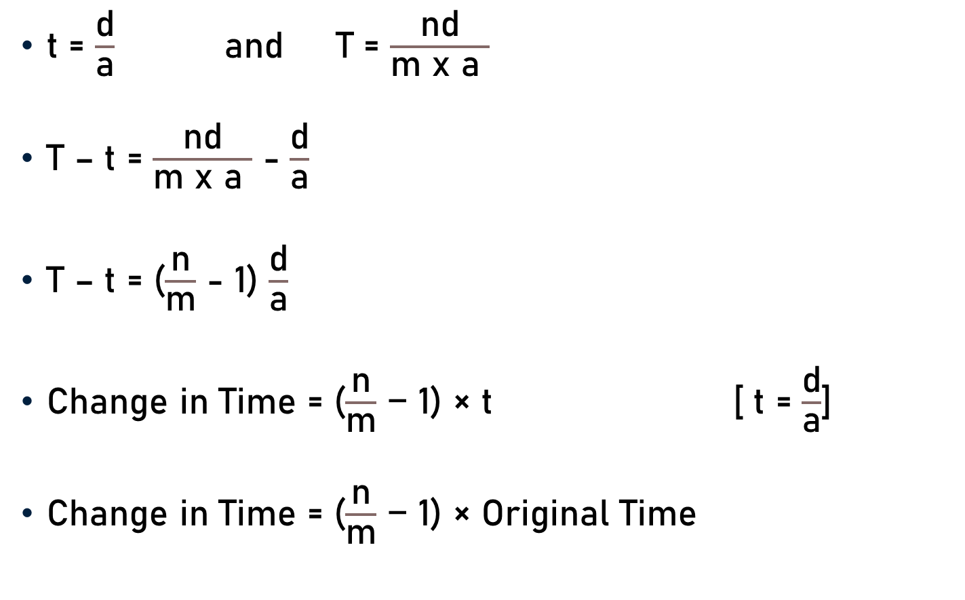
Change in Time – Cover Same Distance
t = $\frac{\text{d}}{\text{a}}$ and T = $\frac{\text{nd}}{\text{m} \text{x} \text{a} }$
T – t = $\frac{\text{nd}}{\text{m} \text{x} \text{a} }$ - $\frac{\text{d}}{\text{a}}$
T – t = ($\frac{\text{n}}{\text{m}}$ - 1) $\frac{\text{d}}{\text{a}}$
Change in Time = ($\frac{\text{n}}{\text{m}}$ − 1) × t [ t = $\frac{\text{d}}{\text{a}}$]
Change in Time = ($\frac{\text{n}}{\text{m}}$ − 1) × Original Time

Slide 24
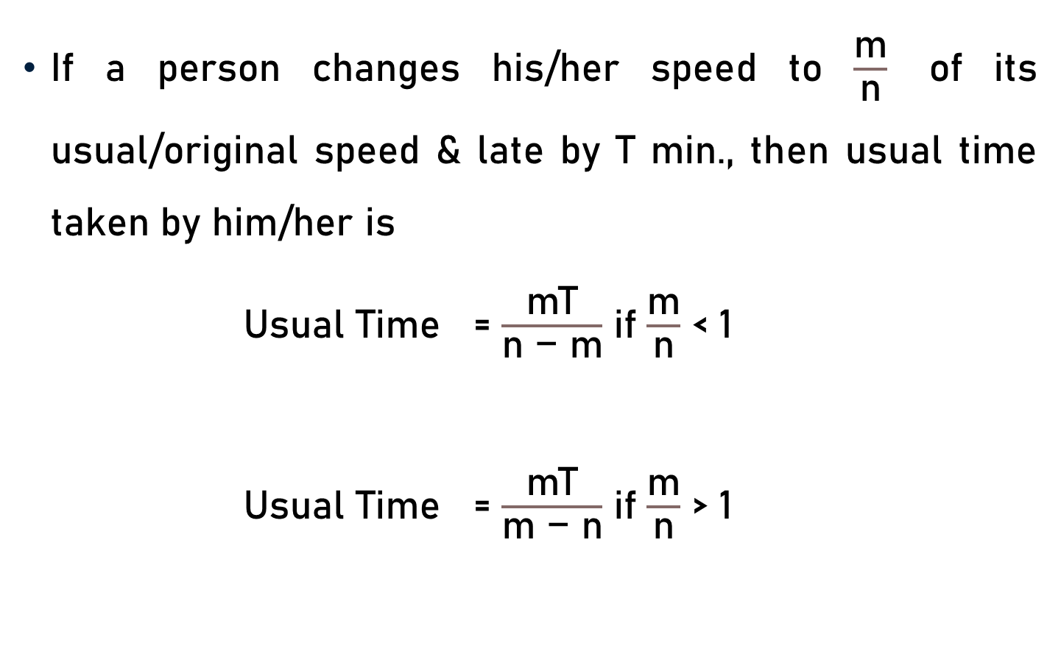
Usual/Original Time
If a person changes his/her speed to $\frac{\text{m}}{\text{n}}$ of its usual/original speed & late by T min., then usual time taken by him/her is
Usual Time = $\frac{\text{mT}}{\text{n}\text{ − }\text{m}}$ if $\frac{\text{m}}{\text{n}}$ < 1
Usual Time = $\frac{\text{mT}}{\text{m}\text{ − }\text{n}}$ if $\frac{\text{m}}{\text{n}}$ > 1

Slide 25
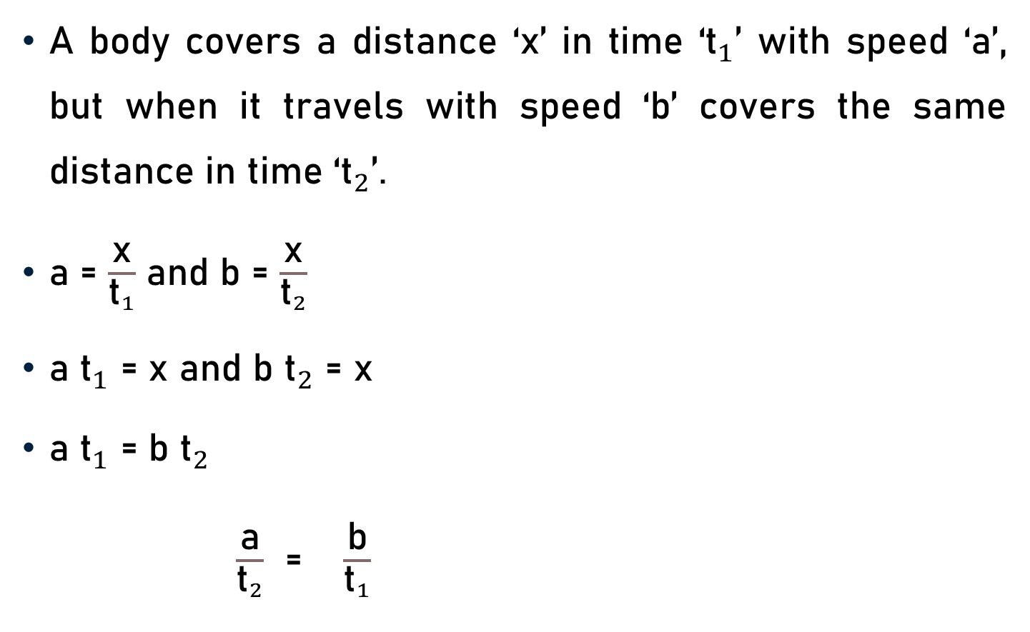
Relation – Speed, Time and Distance
A body covers a distance ‘x’ in time ‘${\text{t}}_{1}$’ with speed ‘a’, but when it travels with speed ‘b’ covers the same distance in time ‘${\text{t}}_{2}$’.
a = $\frac{\text{x}}{{\text{t}}_{1}}$ and b = $\frac{\text{x}}{{\text{t}}_{2}}$
a ${\text{t}}_{1}$ = $\text{x}$ and b ${\text{t}}_{2}$ = $\text{x}$
a ${\text{t}}_{1}$ = b ${\text{t}}_{2}$
$\frac{\text{a}}{{\text{t}}_{2}}$ = $\frac{\text{b}}{{\text{t}}_{1}}$

Slide 26
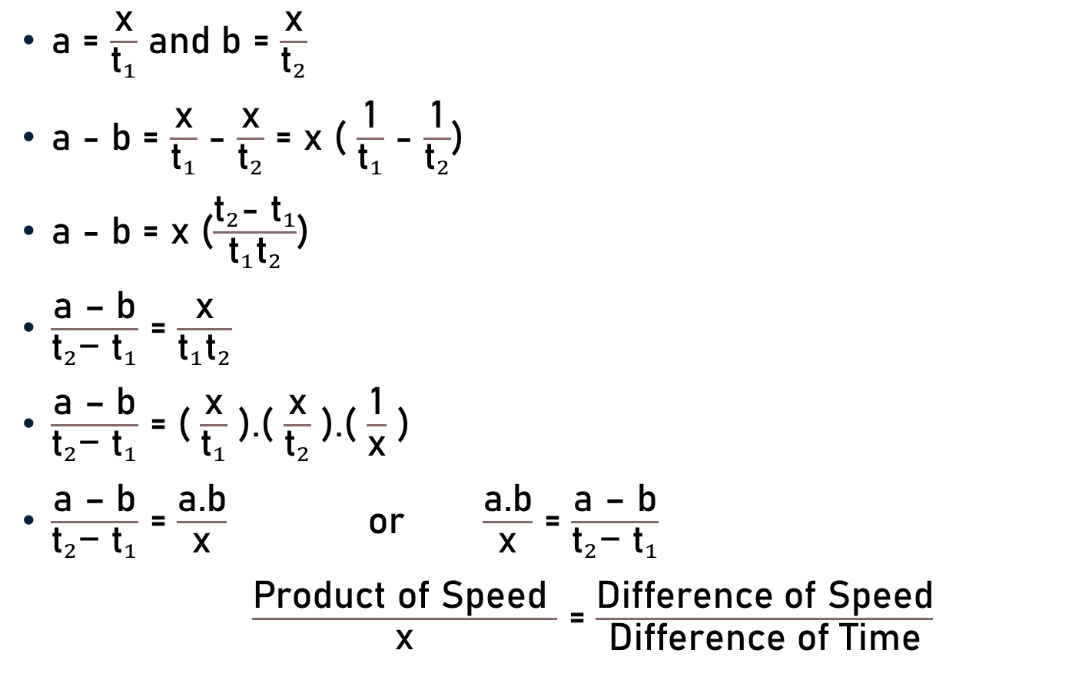
Relation – Speed, Time and Distance
a = $\frac{\text{x}}{{\text{t}}_{1}}$ and b = $\frac{\text{x}}{{\text{t}}_{2}}$
a - b = $\frac{\text{x}}{{\text{t}}_{1}}$ - $\frac{\text{x}}{{\text{t}}_{2}}$ = x ( $\frac{\text{1}}{{\text{t}}_{1}}$ - $\frac{\text{1}}{{\text{t}}_{2}}$)
a - b = x ($\frac{{\text{t}}_{2}{\text{−} \text{t}}_{1}}{{\text{t}}_{1}{\text{t}}_{2}}$)
$\frac{\text{a}\text{ – }\text{b}}{{\text{t}}_{2}{\text{− }\text{t}}_{1}}$ = $\frac{\text{x}}{{\text{t}}_{1}{\text{t}}_{2}}$
$\frac{\text{a}\text{ – }\text{b}}{{\text{t}}_{2}{\text{− }\text{t}}_{1}}$ = ( $\frac{\text{x}}{{\text{t}}_{1}}$ ).( $\frac{\text{x}}{{\text{t}}_{2}}$ ).( $\frac{\text{1}}{\text{x}}$ )
$\frac{\text{a}\text{ – }\text{b}}{{\text{t}}_{2}{\text{− }\text{t}}_{1}}$ = $\frac{\text{a}\text{.}\text{b}}{\text{x}}$ or $\frac{\text{a}\text{.}\text{b}}{\text{x}}$ = $\frac{\text{a}\text{ – }\text{b}}{{\text{t}}_{2}{\text{− }\text{t}}_{1}}$
$\frac{\text{Product} \text{of} \text{S}\text{peed} }{\text{x}}$ = $\frac{\text{Difference} \text{of} \text{S}\text{peed}}{\text{Difference} \text{of} \text{Time}}$

Slide 27
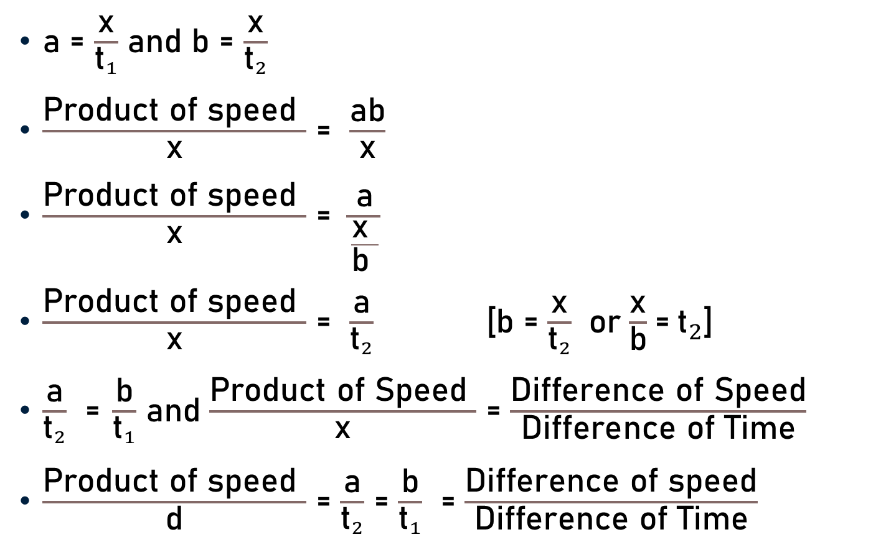
Relation – Speed, Time and Distance
a = $\frac{\text{x}}{{\text{t}}_{1}}$ and b = $\frac{\text{x}}{{\text{t}}_{2}}$
$\frac{\text{Product} \text{of} \text{speed} }{\text{x}}$ = $\frac{\text{ab}}{\text{x}}$
$\frac{\text{Product} \text{of} \text{speed} }{\text{x}}$ = $\frac{\text{a}}{\frac{\text{x} }{\text{b} }}$
$\frac{\text{Product} \text{of} \text{speed} }{\text{x}}$ = $\frac{\text{a}}{{\text{t}}_{2}}$ [b = $\frac{\text{x}}{{\text{t}}_{2}}$ $\text{o}\text{r}$ $\frac{\text{x}}{\text{b}}$ = ${\text{t}}_{2}$]
$\frac{\text{a}}{{\text{t}}_{2}}$ = $\frac{\text{b}}{{\text{t}}_{1}}$ and $\frac{\text{Product} \text{of} \text{S}\text{peed} }{\text{x}}$ = $\frac{\text{Difference} \text{of} \text{Speed}}{\text{Difference} \text{of} \text{Time}}$
$\frac{\text{Product} \text{of} \text{speed} }{\text{d}}$ = $\frac{\text{a}}{{\text{t}}_{2}}$ = $\frac{\text{b}}{{\text{t}}_{1}}$ = $\frac{\text{Difference} \text{of} \text{speed}}{\text{Difference} \text{of} \text{Time}}$

Slide 28
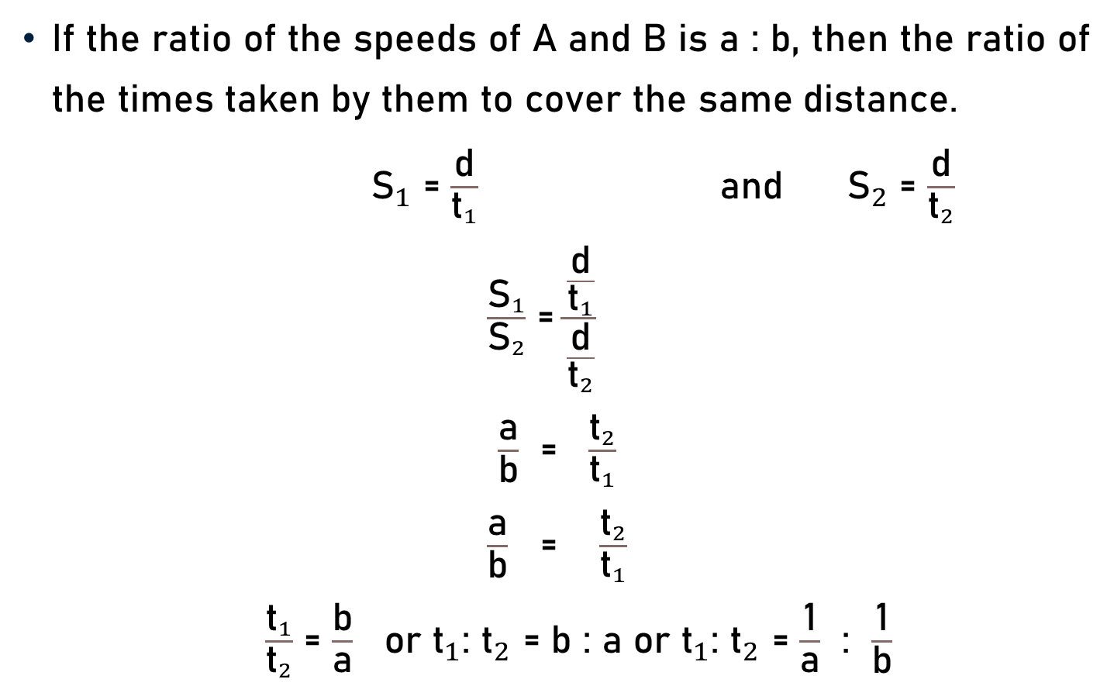
Ratio of Speed & Time
If the ratio of the speeds of A and B is a : b, then the ratio of the times taken by them to cover the same distance.
${\text{S}}_{1}$ = $\frac{\text{d}}{{\text{t}}_{1}}$ and ${\text{S}}_{2}$ = $\frac{\text{d}}{{\text{t}}_{2}}$
$\frac{{\text{S}}_{1}}{{\text{S}}_{2}}$ = $\frac{\frac{\text{d}}{{\text{t}}_{1}}}{\frac{\text{d}}{{\text{t}}_{2}}}$
$\frac{\text{a}}{\text{b}}$ = $\frac{{\text{t}}_{2}}{{\text{t}}_{1}}$
$\frac{\text{a}}{\text{b}}$ = $\frac{{\text{t}}_{2}}{{\text{t}}_{1}}$
$\frac{{\text{t}}_{1}}{{\text{t}}_{2}}$ = $\frac{\text{b}}{\text{a}}$ or ${\text{t}}_{1}$: ${\text{t}}_{2}$ = b : a or ${\text{t}}_{1}$: ${\text{t}}_{2}$ = $\frac{\text{1}}{\text{a}}$ : $\frac{\text{1}}{\text{b}}$

Slide 29

Conclusion
Speed = $\frac{\text{Distance} \text{Travelled}}{\text{Time} \text{Taken}}$
Speed x $\text{Time}$=$\text{Distance}$
$\text{Time}$= $\frac{\text{Distance}}{\text{Speed}}$
$\text{1}$ Km/h = $\frac{\text{5} }{\text{18 }}\text{m}\text{/}\text{s}$ & $\text{1}$ $\text{m}\text{/}\text{s}$ = $\frac{\text{18} }{\text{5 }}$ Km/h
Average Speed = $\frac{\text{Total} \text{Distance} \text{Covered} }{\text{Total} \text{Time} \text{Taken} }$

Slide 30
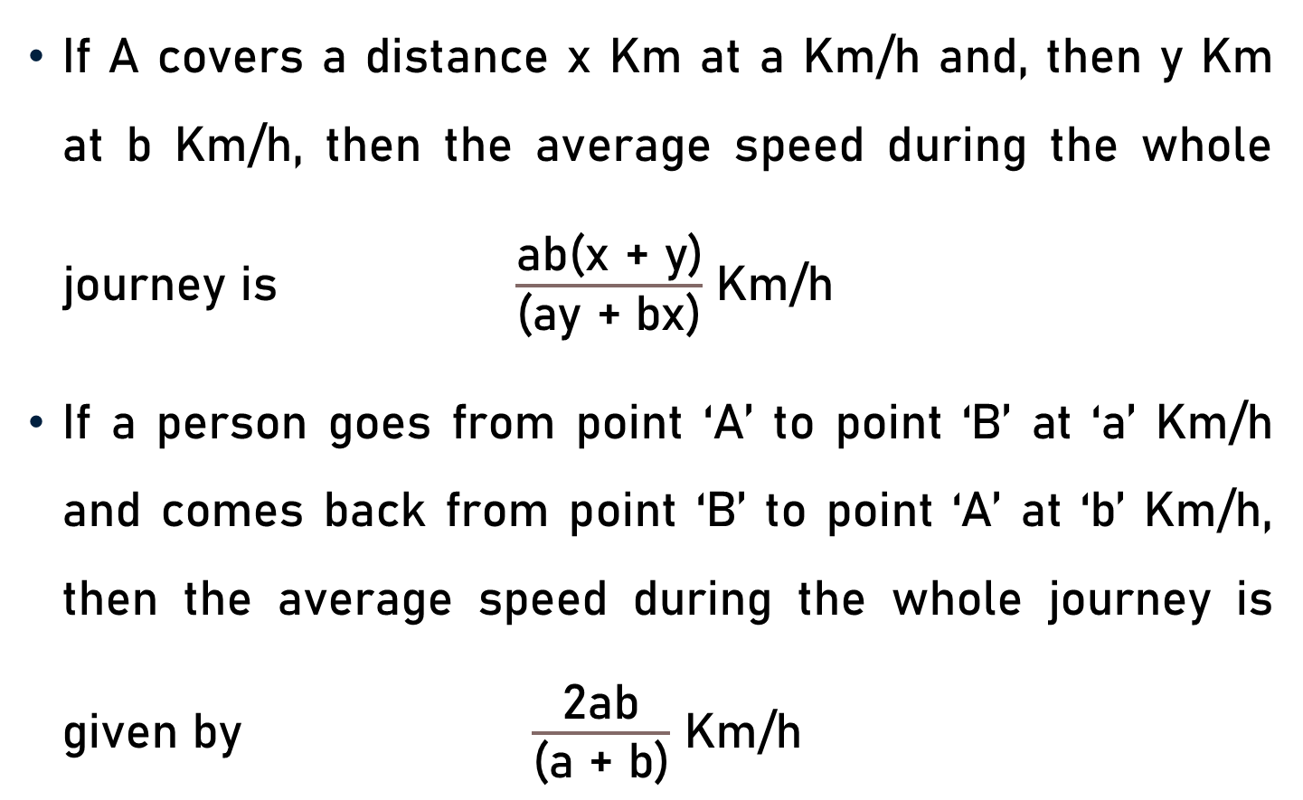
Conclusion
If A covers a distance x Km at a Km/h and, then y Km at b Km/h, then the average speed during the whole journey is $\frac{\text{ab}\text{(}\text{x}\text{ + }\text{y}\text{)}}{\text{(}\text{ay}\text{ + }\text{bx}\text{)}}$ Km/h
If a person goes from point ‘A’ to point ‘B’ at ‘a’ Km/h and comes back from point ‘B’ to point ‘A’ at ‘b’ Km/h, then the average speed during the whole journey is given by $\frac{\text{2}\text{ab}}{\text{(}\text{a}\text{ + }\text{b}\text{)}}$ Km/h

Slide 31
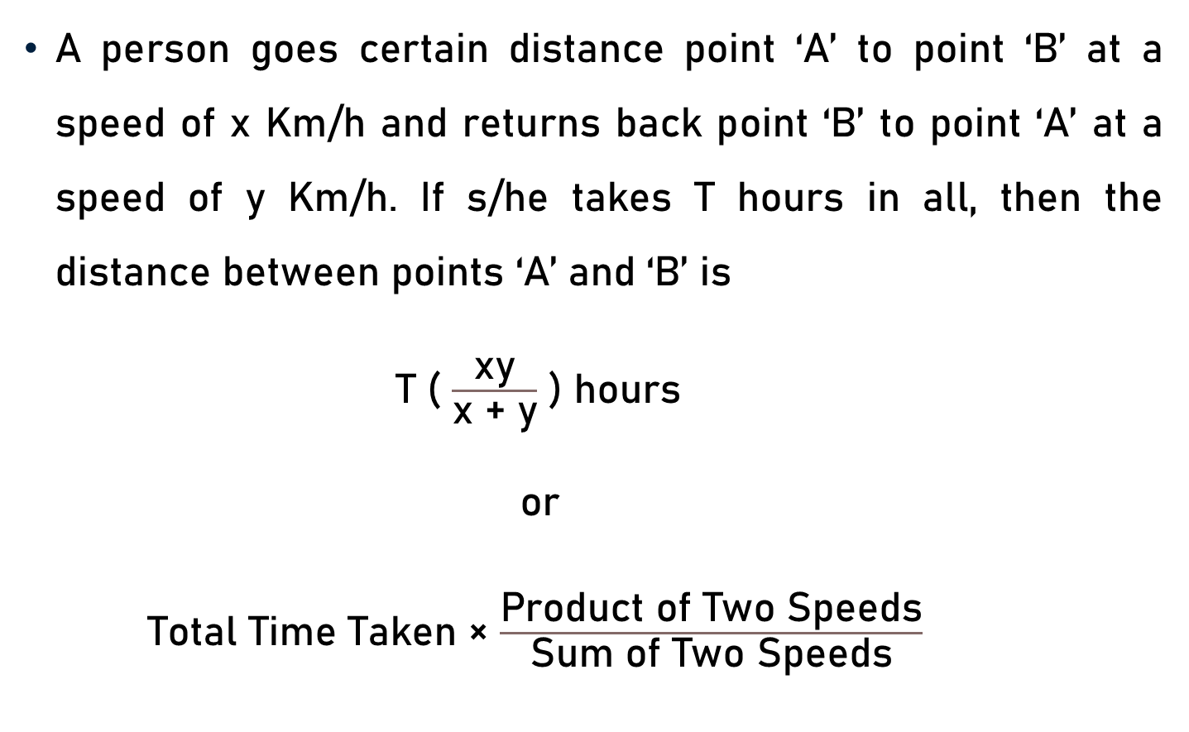
Conclusion
A person goes certain distance point ‘A’ to point ‘B’ at a speed of x Km/h and returns back point ‘B’ to point ‘A’ at a speed of y Km/h. If s/he takes T hours in all, then the distance between points ‘A’ and ‘B’ is
T ( $\frac{\text{xy}}{\text{x}\text{ + }\text{y}}$ ) hours
or
Total Time Taken × $\frac{\text{Product} \text{of} \text{T}\text{wo} \text{S}\text{peeds}}{\text{Sum} \text{of} \text{T}\text{wo} \text{S}\text{peeds}}$

Slide 32
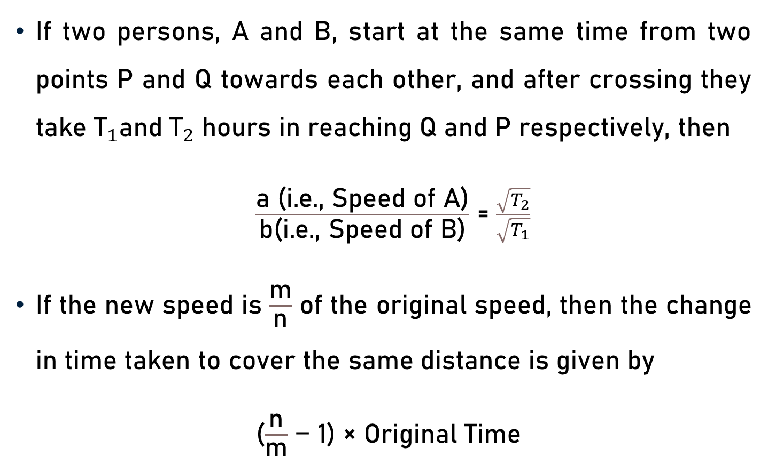
Conclusion
If two persons, A and B, start at the same time from two points P and Q towards each other, and after crossing they take ${\text{T}}_{1}$and ${\text{T}}_{2}$ hours in reaching Q and P respectively, then
$\frac{\text{a}\text{ (}\text{i}\text{.}\text{e}\text{., }\text{Speed} \text{of} \text{A}\text{)}}{\text{b}\text{(}\text{i}\text{.}\text{e}\text{., }\text{Speed} \text{of} \text{B}\text{)}}$ = $\frac{\sqrt{T_{2}}}{\sqrt{T_{1}}}$
If the new speed is $\frac{\text{m}}{\text{n}}$ of the original speed, then the change in time taken to cover the same distance is given by
($\frac{\text{n}}{\text{m}}$ − 1) × Original Time

Slide 33
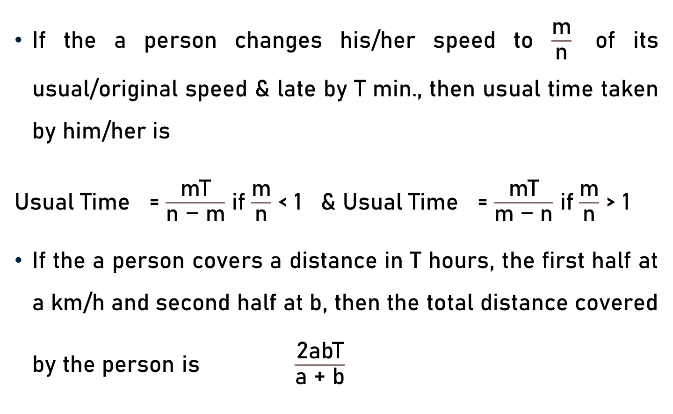
Conclusion
If the a person changes his/her speed to $\frac{\text{m}}{\text{n}}$ of its usual/original speed & late by T min., then usual time taken by him/her is
Usual Time = $\frac{\text{mT}}{\text{n}\text{ − }\text{m}}$ if $\frac{\text{m}}{\text{n}}$ < 1 & Usual Time = $\frac{\text{mT}}{\text{m}\text{ − }\text{n}}$ if $\frac{\text{m}}{\text{n}}$ > 1
If the a person covers a distance in T hours, the first half at a km/h and second half at b, then the total distance covered by the person is $\frac{\text{2}\text{abT}}{\text{a}\text{ + }\text{b}}$

Slide 34
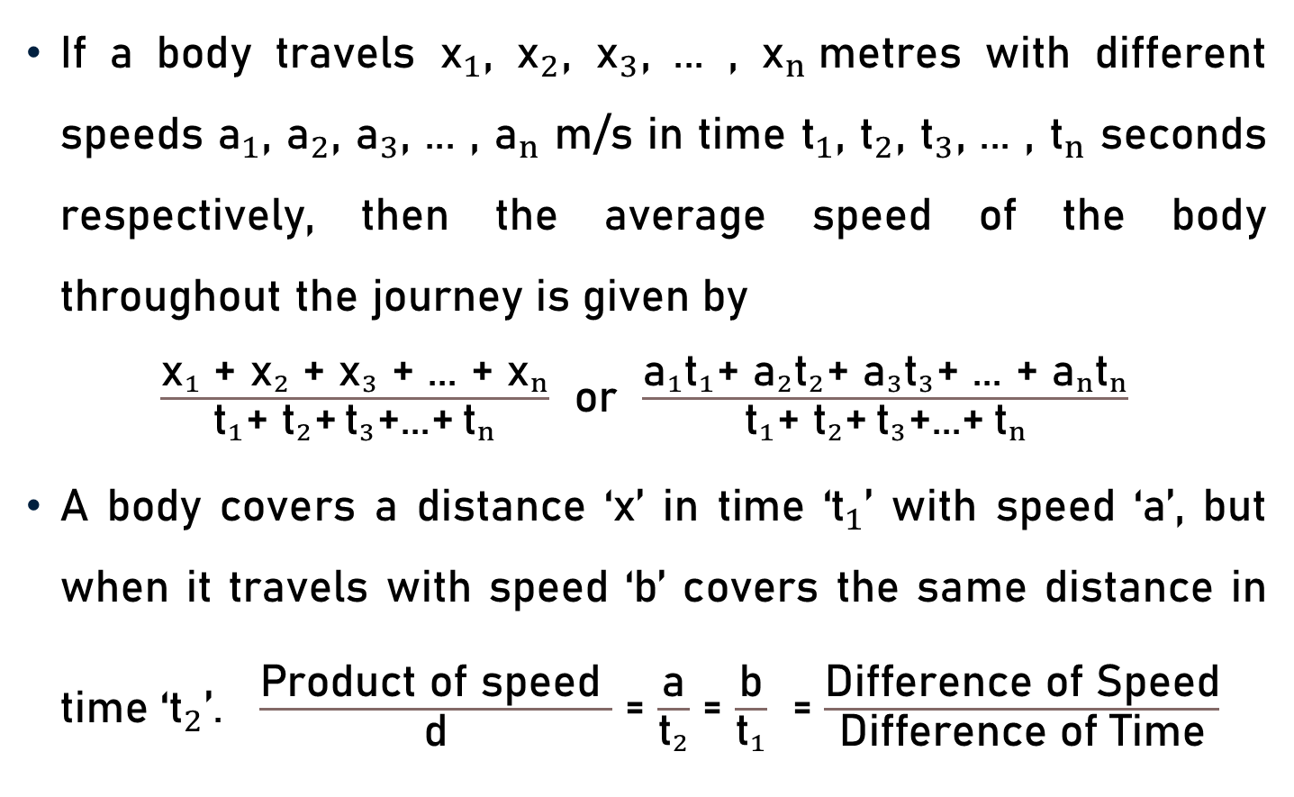
Conclusion
If a body travels ${\text{x}}_{1}$, ${\text{x}}_{2}$, ${\text{x}}_{3}$, ... , ${\text{x}}_{n}$metres with different speeds ${\text{a}}_{1}$, ${\text{a}}_{2}$, ${\text{a}}_{3}$, ... , ${\text{a}}_{n}$ m/s in time ${\text{t}}_{1}$, ${\text{t}}_{2}$, ${\text{t}}_{3}$, ... , ${\text{t}}_{n}$ seconds respectively, then the average speed of the body throughout the journey is given by
$\frac{{\text{x}}_{1}\text{ +} {\text{x}}_{2}\text{ +} {\text{x}}_{3}\text{ +}\text{ ... }\text{+} {\text{x}}_{n}}{{\text{t}}_{1}\text{+} {\text{t}}_{2}\text{+} {\text{t}}_{3}\text{+...+} {\text{t}}_{n}}$ or $\frac{{\text{a}}_{1}{\text{t}}_{1}\text{+ }{\text{a}}_{2}{\text{t}}_{2}\text{+ }{\text{a}}_{3}{\text{t}}_{3}\text{+ ... + }{\text{a}}_{n}{\text{t}}_{n}}{{\text{t}}_{1}\text{+ }{\text{t}}_{2}\text{+} {\text{t}}_{3}\text{+...+} {\text{t}}_{n}}$
A body covers a distance ‘x’ in time ‘${\text{t}}_{1}$’ with speed ‘a’, but when it travels with speed ‘b’ covers the same distance in time ‘${\text{t}}_{2}$’. $\frac{\text{Product} \text{of} \text{speed} }{\text{d}}$ = $\frac{\text{a}}{{\text{t}}_{2}}$ = $\frac{\text{b}}{{\text{t}}_{1}}$ = $\frac{\text{Difference} \text{of} \text{S}\text{peed}}{\text{Difference} \text{of} \text{Time}}$

Slide 35
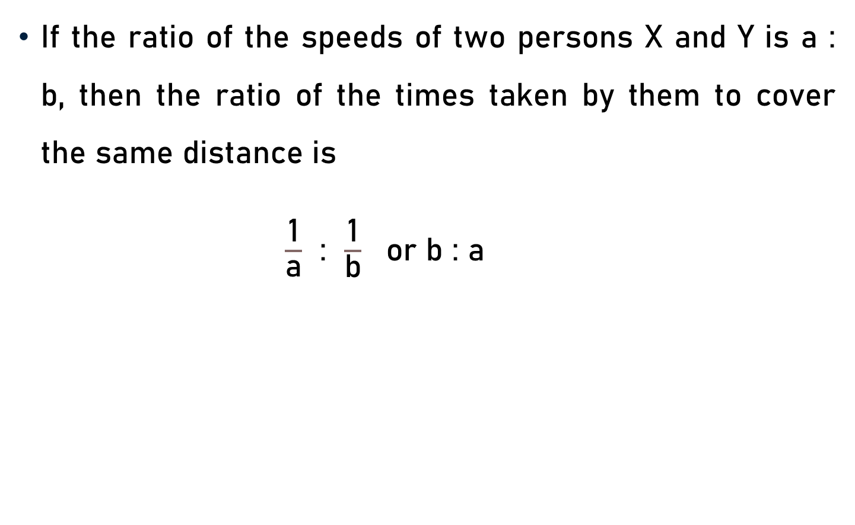
Conclusion
If the ratio of the speeds of two persons X and Y is a : b, then the ratio of the times taken by them to cover the same distance is
$\frac{\text{1}}{\text{a}}$ : $\frac{\text{1}}{\text{b}}$ or b : a

Slide 36
Summary
Basic Concepts
  Speed, Distance, Time, & Average Speed
  Units of Measurement
Conversion of Units
Speed, Distance, Time, & Average Speed
  Important Facts
  Formulae

